Slide 1

Welcome to Prospect School! Prospect School is applying for authorization to become an International Baccalaureate World School. Aligned with the IB Primary Years Program philosophy and standards, our school mission aims to inspire students to become lifelong learners who are globally minded. We will create opportunities for students to be active inquirers, thinkers and contributing members of society.
How will we accomplish this mission? Together as a community!
!
Let’s look at the next few slides to get a glimpse of what the International Baccalaureate Primary Years Program is all about. Please request a school brochure explaining more about the IB PYP program from your child’s teachers or visit our school website and click on IB PYP at the top of the screen.

Slide 2
The IB PYP program values 10 learner profile attributes. IB learners are internationally minded individuals that strive to create a better world through understanding the world’s global interconnectedness and humanity. As a school we will introduce and model the attributes and highlight one each month. Parents are encouraged to reinforce each attribute at home. Students who exhibit the monthly attribute at school will receive an award and be acknowledged at our monthly PTO meetings.
.

Slide 3
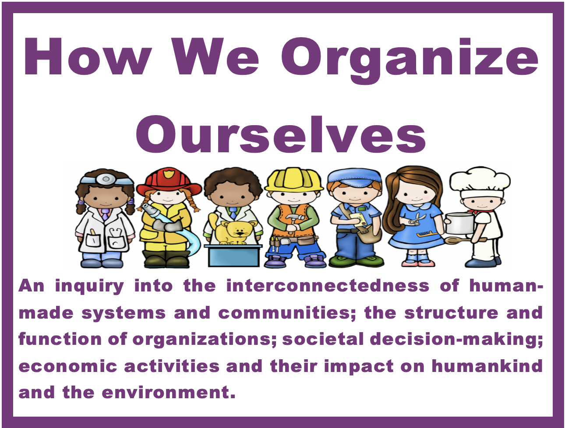


Each grade will engage in 4 Transdisciplinary Themes. Our first unit is Who We Are. Students will learn and share about themselves, their family and culture. Please complete the family survey and return it to your child’s teacher.
The unit will culminate in November with Who We Are Day. Students and staff will come to school dressed in their native country’s national dress and flag, favorite team jersey, or what they want to be when they grow up.

Slide 4
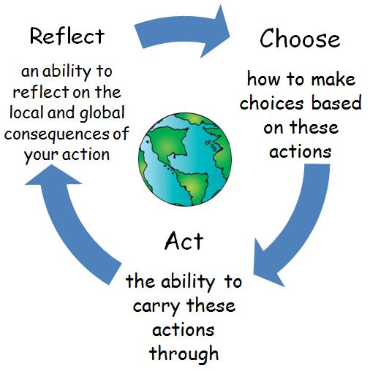
As students explore each theme, they will be asked to reflect on what they’ve learned and take action as a school or an individual. This is called the Action Cycle.
For example: Students learn the need to take care of the earth and keep our community clean. As a school we can decide to have a clean up day. As an individual students can take action by recycling bottles instead of throwing them in the trash.
October is Breast Cancer Awareness month. Our first school action to foster caring for others is to dress in pink on October 20th & 23rd and donate $1 to the American Cancer Society to help find a cure.

Slide 5
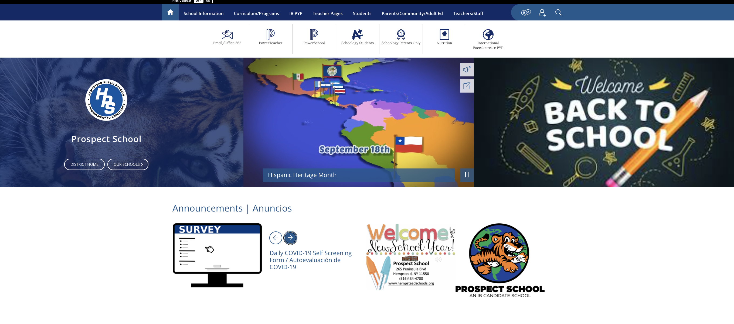
Visit our School Website to Stay Informed
www.hempsteadschools.org – Click on Prospect School

